Slide 1
Year 6 SATs
Information Evening
2024

Slide 2
Contents
•Introduction to SATs
•Teacher assessments and testing
•Results
•About the tests
•Preparing your child
•Questions

Slide 3
Year 6 Key Stage 2 Tests
SATs, or Standard Assessment Tests, are the name for National Curriculum Tests.
They are statutory end of Key Stage tests designed with all pupils working at the standard of the National Curriculum.
They are taken in Maths, Reading and SPaG
(spelling, punctuation and grammar)
Papers are sent away for independent marking and returned to the school. The staff check the papers for accuracy of marking and tallying the marks as mistakes have been found in the past.

Slide 4
Year 6 Teacher Assessments
•Teacher assessment alone is used to assess writing.
•Schools are also required to report a teacher assessment for reading, mathematics and science.
•Schools are using interim teacher assessment frameworks to make judgements for pupils in these subjects.

Slide 5
Teacher Assessment ‘Writing’
KS2 writing standards
•Working towards the expected standard
•Working at the expected standard
•Working at greater depth within the expected standard
•Additional categories for those not “Working towards.”
We may have a ‘Writing Moderator’ visit to check our assessments.

Slide 6
English Writing Teacher Assessment
• Significantly higher expectations
• No longer a best fit assessment
• Each criterion must be met

Slide 7
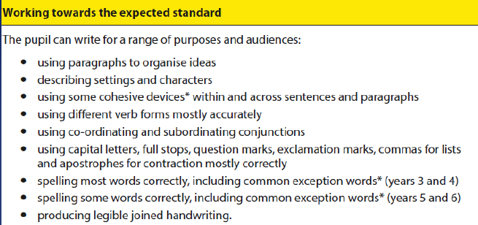

Slide 8
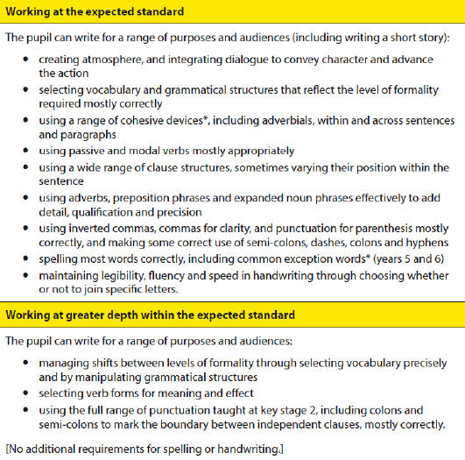

Slide 9
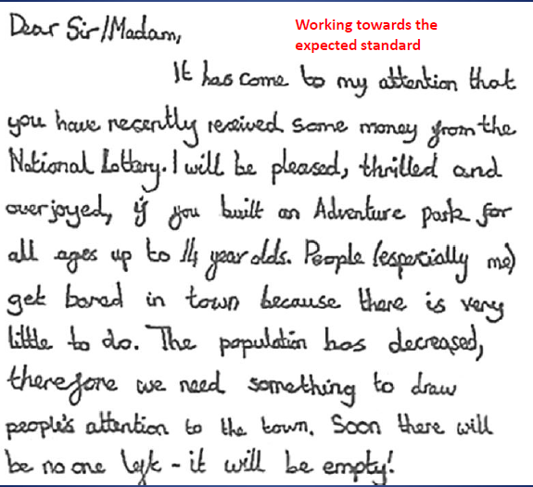

Slide 10
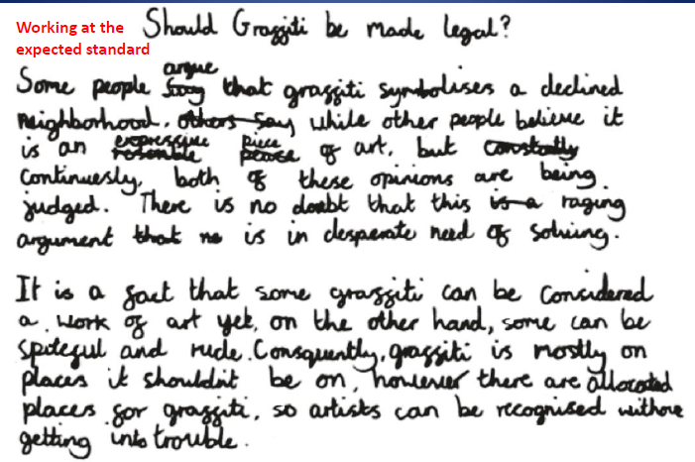

Slide 11
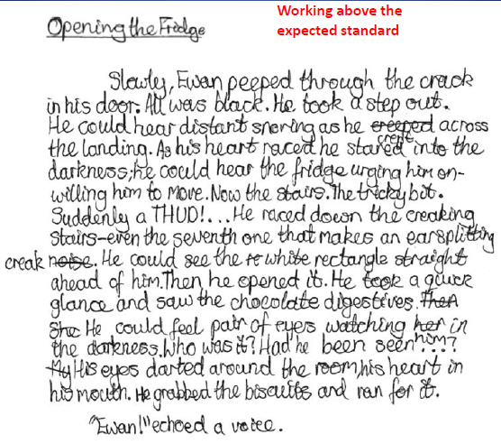

Slide 12
Teacher Assessment
KS2 reading, mathematics and science standards:
•Working at the expected standard
•Additional category for those not “Working at.”

Slide 13
A word of warning
•Teacher Assessments are no longer ‘best fit’. To demonstrate that pupils have met a standard, teachers will need to have evidence that a pupil demonstrates all of the statements in that standard and all the statements in the preceding standards.
•The new assessments have had a very definite rise in expectations. A child now has to be able to do a lot more to be at the expected standard this year than they had do in previous years.
•The range of results is far fewer, so reporting the statutory results to parents may be less clear.

Slide 14
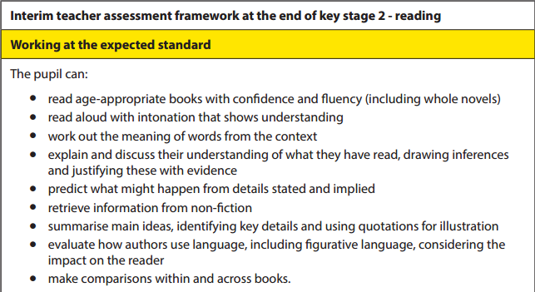
Teacher Assessment ‘Reading’

Slide 15
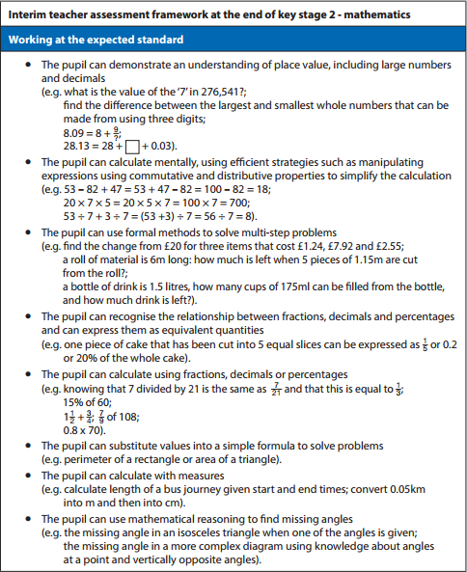
Teacher Assessment ‘Maths’

Slide 16
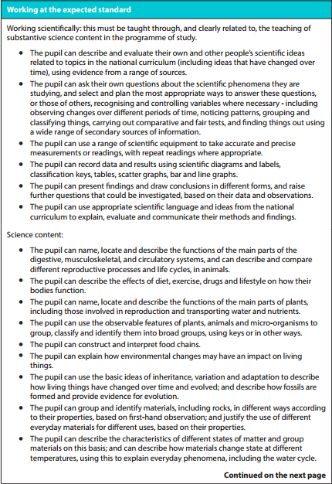
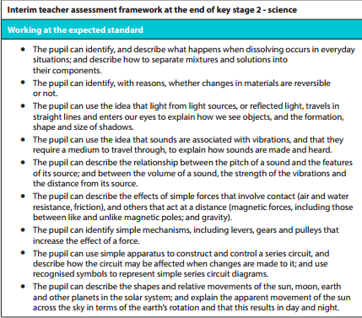
Teacher Assessment ‘Science’

Slide 17
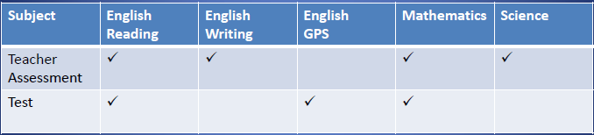
Summary of Assessments

Slide 18


Slide 19
Test Results
•From 2016, KS2 national curriculum test outcomes will no longer be reported using levels. Scaled scores will be used instead.
•Instead of receiving levels as has happened in previous years, each pupil sitting the tests will receive:
–A raw score – the total number of marks scored in the test
–A scaled score – based on the raw score converted after the test. This is to ensure consistency year on year
–100 = threshold/met the standard expected
–Confirmation of whether or not they have attained the national standard.

Slide 20
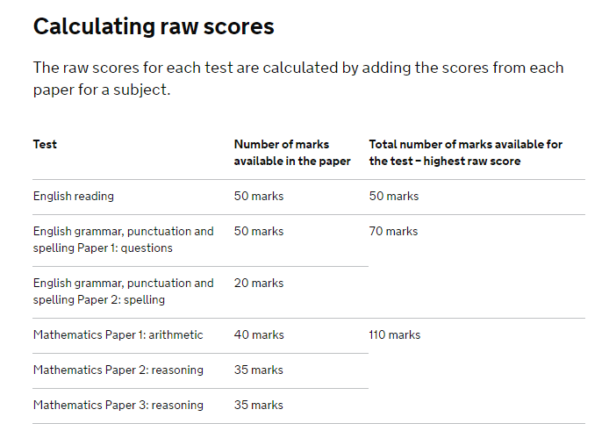

Slide 21
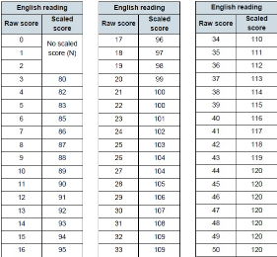
Scaled Scores – ‘Reading’

Slide 22
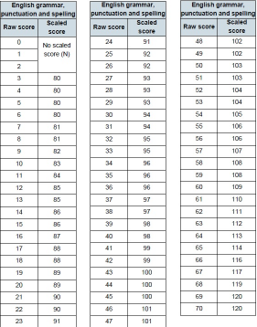
Scaled Scores – ‘GPS’

Slide 23
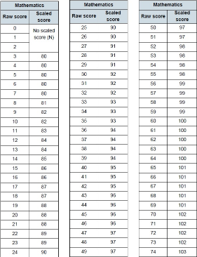
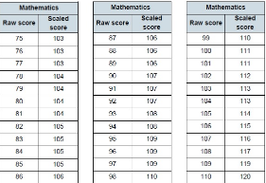
Scaled Scores – ‘Maths’

Slide 24
English Reading Test
•The test:
–Reading booklet (Selection of texts – 1500-2300 words – not related by theme)
–Answer booklet (50 marks in 60 mins including reading time)
–More challenging questions towards the end of the paper
–No Level 6 paper
•Marked externally
•Raw score (out of 50) converted to a scaled score
•Each pupil given an overall result indicating if they have met the required standard

Slide 25
English Reading Test
•Question types
–Selected response
•Multiple choice; ranking, ordering; matching; labelling
–Short, constructed response
•Find and copy; name, state, give
–Extended response
•Explain; describe

Slide 26
English Reading Test
•What’s being assessed?
–Retrieve and record information
–Make inferences
–Give/explain the meaning of words in context
–Summarise main ideas from a text
–Predict what might happen
–Understand how content is related and
contributes to meaning
–Understand how meaning is enhanced through
language

Slide 27
English Reading Test
•Unfamiliar question types:
1. Predict what might happen from details stated and implied e.g. Based on what you have read, what does the last paragraph suggest might happen next? Use evidence from this paragraph to support your prediction.
2. Explaining and understanding vocabulary in context.
3. Make comparisons within texts
e.g. How does <character’s name> mood change?

Slide 28
English GPS
(Grammar, Punctuation and Spelling) Test
• The test:
–Paper 1 (Grammar and punctuation) Short answer questions. 50 marks in 45 minutes.
–Paper 2 (Spelling test) 20 target words in contextualised sentences. 20 marks in approx. 15 minutes.
–More challenging questions / words towards the end of the papers
–No Level 6 paper
• Marked externally
• Raw score (out of 70) converted to a scaled score
• Each pupil given an overall result indicating if they have met the required standard.

Slide 29
English SPaG
(Spelling, Punctuation and Grammar)
Test.
• What’s being assessed?
–Grammatical terms / word classes
–Function of sentences
–Combining words, phrases and clauses
–Verb forms, tense and consistency
–Punctuation
–Vocabulary
–Standard English and formality
–Make comparisons within a text

Slide 30
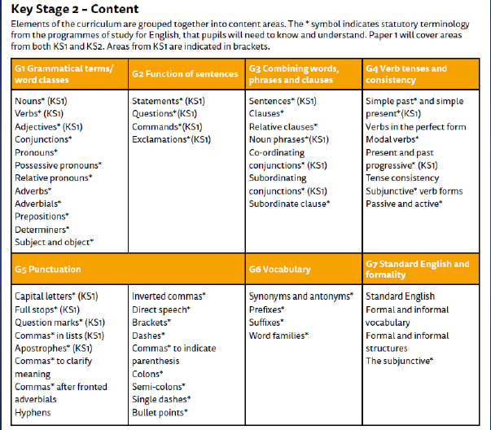

Slide 31
English
Test.
New or previously untested areas:
• Adverbials
• Determiners
• Subject and object
• Relative clauses
• Noun phrases
• Modal verbs
• Present and past
progressive tenses
•Subjunctive verb forms
•Passive and active forms
•Semi-colons
•Hyphens to avoid ambiguity
•Possessive and relative pronouns
•Present and past perfect form

Slide 32
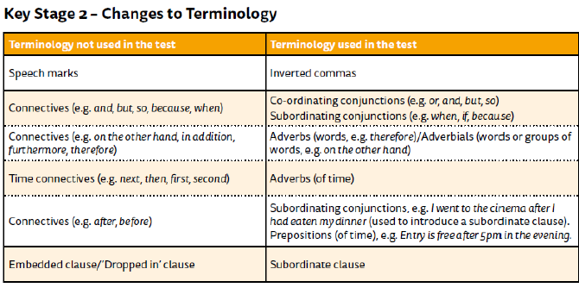

Slide 33
Mathematics Test
The test:
– Paper 1 – Arithmetic (40 marks in 30 mins)
– Paper 2 – Reasoning (35 marks in 40 mins)
– Paper 3 – Reasoning (35 marks in 40 mins)
– More challenging questions towards the end of the paper
– No Level 6 paper
• Marked externally
• Raw score (out of 110) converted to a scaled
score
• Each pupil given an overall result indicating if
they have met the required standard .

Slide 34
Mathematics Test
• What’s being assessed?
– Number and place value, approximation and estimation/rounding
– Four rules (calculations)
– Fractions, decimals and percentages
– Ratio and proportion
– Algebra
– Measurement
– Geometry: position and direction
– Statistics

Slide 35
Mathematics Test
Key changes:
–Written arithmetic paper replaced the mental maths paper
– Method marks only available for use of standard long multiplication and division methods on relevant questions.
– The tests are more challenging to match the new higher expectations of the new National Curriculum.

Slide 37
How is SATs week organised?
• The tests are carried out in familiar surroundings with as much sensitivity as it is possible, mainly in the classroom.
The lead invigilator will be the Headteacher.
• Everything will be done to help your child feel at ease and to allow them to give of their best.

Slide 38
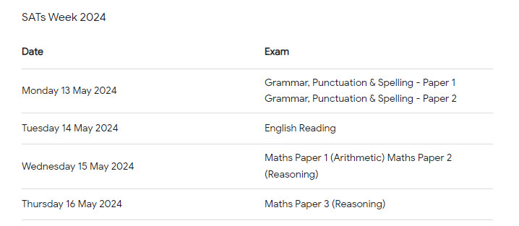
Y6 Test Timetable

Slide 39
Preparing your children
• Practice papers
• Ensuring curriculum coverage
• Consolidation and revision of key
topics
• Revision packs (Over Easter)
• Emotional support
• Mock SATs week
– although we already test at the end
of each half-term.

Slide 40
How can you help?
SATs can be a worrying time for your child and can lead to nervousness as the tests approach. Good coping strategies include:
• Reassure them that they just have to try their best on the day.
• Remind them that in most parts of the SATs papers, children do not have to write in sentences: often phrases or even single words will be enough.
• Teach them how to relax by breathing deeply and closing their eyes to picture a calm scene like a green field by a river.
• Allow them to choose a small favourite toy to take in for comfort.
• Keep an early and regular bedtime routine in the days leading up to and including the test week – no later that 8.30 p.m.!
• Ensure your child has breakfast every day, especially during the week of the tests. Research shows that children who miss breakfast perform worse in late morning.
• Check your child can tell the time accurately so they will know how long there is to go in the test.

Slide 41
Easter
All children will have some ‘Revision work’ to complete over the Easter break.
They should complete some most days, at least 10-15 minutes for each subject. This is to keep them ‘ticking over’. We cannot afford to have 2 weeks off and forget everything.
There will be:
Comprehensions (10 minute Test)
Arithmetic (At least 5 questions using all operations and fractions, decimals and %)
Reasoning
GPS (10 minute tests)
Writing (Success Criteria will be provided.)

Slide 42
Useful web-sites
Sample papers:
https://www.gov.uk/government/publications/2016-key-stage-2-mathematics-sample-test-materials-mark-schemes-and-test-administration-instructions
https://www.gov.uk/government/publications/2016-key-stage-2-english-reading-sample-test-materials-mark-scheme-and-test-administration-instructions
https://www.gov.uk/government/publications/2016-key-stage-2-english-grammar-punctuation-and-spelling-sample-test-materials-mark-scheme-and-test-administration-instructions

Slide 43
IXL – Sign up for 30 days free trial. Games/ activities https://uk.ixl.com/
http://www.bbc.co.uk/bitesize/ks2/

Slide 44

Questions?

